Slide 1
SAFE AND SUPPORTED YOUTH An Overview of LGBTQ Cultural Competency

Slide 2
Key Beck
they, them, their
LGBTQ Training Specialist
Black/ Person of Color
Queer/Nonbinary/Transgender
Differently Abled

Slide 3
Pronouns
Everybody has them!
Gender pronouns refer to people being talked about when not using a name.
He/Him/His
She/Her/Hers
Gender Neutral Pronouns
They/Them/Theirs, Ze/Zie

Slide 4
SOGIE Overview
Sexual Orientation
The inner feelings of who we are attracted or oriented to sexually and emotionally
Examples: lesbian, gay, bisexual, pansexual, asexual
Gender Identity
How we identify ourselves in terms of our gender
Examples: transgender, nonbinary, agender, cisgender
Gender Expression
An individual’s physical characteristics, behaviors and presentation that are linked, traditionally, to either masculinity or femininity, such as: appearance, dress, mannerisms, speech patterns and social interactions
Examples: gender nonconforming, gender expansive, gender creative, androgynous

Slide 5
Gender Unicorn
Notes:
Intersex is a variety of conditions in which a person is born with a reproductive or sexual anatomy that doesn’t seem to fit the typical definitions of female or male.
Intersex is a socially constructed category that reflects biological variation.

Slide 6
The LGBTQ Experience
Universality
Cumulative
Institutional
Notes:
Universality – the experiences we’re going to talk about are related to youth but LGBTQ adults also experience these throughout their lifespan in many settings. The strategies and experience we discuss this afternoon are applicable to all LGBTQ folks.
Cumulative– the process of coming out is a continual one, so as LGBTQ youth grow into adults, they will have to continually navigate the process coming out, handling disclosures and other identity-specific processes (i.e.: explanation of pronouns, etc.). the experience of exclusion and non-acceptance doesn’t only happen at one particular point in life. These behaviors happen often in my different environments and situations from childhood through adulthood. And those acts of exclusion are cumulative, as multiple forms of oppression are being compounded throughout a lifetime.
Institutional – many of the forms of oppression and prejudice that we are discussing are ingrained into societies’ laws, policies and systems as a whole. So it is important to note that as young people move through these systems they may encounter multiple forms of oppression that compound their lived experiences.

Slide 7
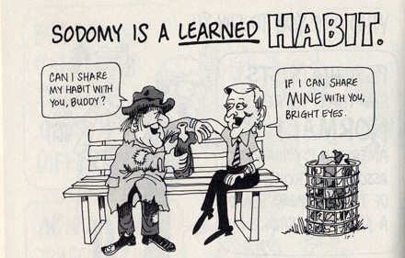
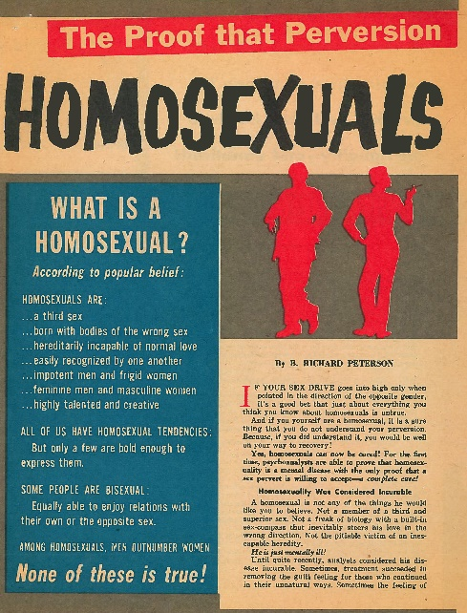
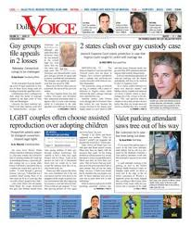
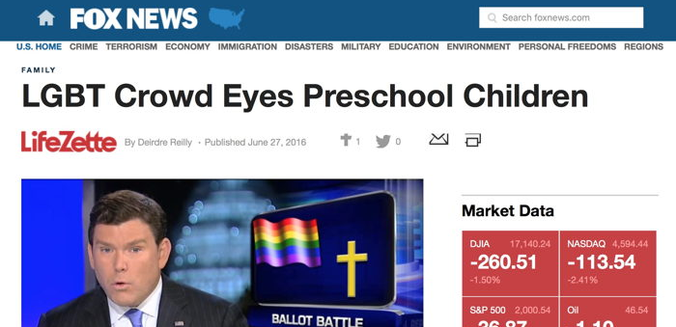
Messages & Values

Slide 8
Values
We have values!
They challenge us!
We must find balance!
We have an obligation!

Slide 9
Safety
SCHOOLS ARE UNWELCOMING FOR THE MAJORITY OF LGBTQ STUDENTS
Perceptions of Safety
60%
Felt unsafe because of sexual orientation
45%
Felt unsafe because of gender expression
Avoiding Harm
35%
Missed at least one day of school because they felt unsafe
75%
Avoid school functions because they felt unsafe
Harassment and Assault
70%
Were called names or threatened because of sexual orientation
87%
Heard derogatory remarks specifically about transgender people

Slide 10
Psychological Distress
LGBTQ INDIVIDUALS
8X MORE LIKELY TO
REPORT EXPERIENCING SERIOUS PHYSCHOLOGICAL DISTRESS
THAN NON-LGBTQ
INDIVIDUALS
Psychological distress was associated with a variety of experiences of rejection, discrimination, and violence:
64%
LGB youth report feeling unsafe
at school due to SOGIE
44%
Transgender youth report feeling unsafe at school due to SOGIE
66%
Experienced some form of discrimination based on SOGIE
30%
Physically threatened or
attacked
Notes:
Health and Access to Care and Coverage for Lesbian, Gay, Bisexual, and Transgender (LGBT) Individuals in the U.S.

Slide 11
Barriers to Care
LGBTQ INDIVIDUALS
FACE BARRIERS
ACCESSING
HEALTHCARE
COMPARED TO
NON-LGBTQ FOLX
Barriers To Care
33%
Reported at least one negative experience with a provider
24%
Felt their provider had a lack of knowledge of appropriate care
15%
Were asked invasive or unnecessary questions about being transgender
23%
Reported needing health care, but did not seek it due to fear of being disrespected/mistreated

Slide 12
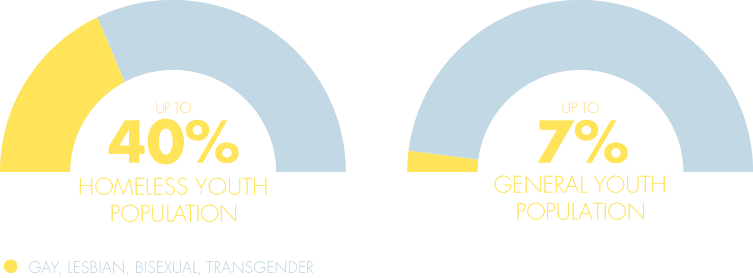
LGBTQ Youth Homelessness
Notes:
LGBTQ youth make up about 7% of the youth population and up to 40% of the Homeless youth population. In fact, LGBTQ youth are 2.2X more likely to become homeless than their peers. Why do you think queer and trans youth are so over represented among homeless youth? You’re right! Family rejection

Slide 13
Consequences
SUICIDE
8x More Likely
DRUG USE
3x More Likely
CONSEQUENCES
UNSAFE SEX
3x More Likely
DEPRESSION
6x More Likely
Notes:
When talking about the consequences of family rejection, try to illustrate that there difference between high levels of family rejection and low levels of family rejections.
2-3 times more likely to have a mental health disorder.

Slide 14
Consequences (General)
DEPRESSION
2.5x More Likely
ANXIETY
2.5x More Likely
CONSEQUENCES
SUBSTANCE MISUSE
2.5x More Likely
MENTAL HEALTH DISORDER
2-3x More Likely
Division of Diversity and Health Equity. Updated and reviewed, respectively, by Jeremy Kidd, M.D., and the Council on Minority Mental Health and Heath Disparities

Slide 15
Client-Centered Approach
Empathy-based
Trauma-informed
Equal Partnership, but Client-led
Respectful of Client’s Values and Beliefs
Notes:
Youth-centered approach means putting youth at the center of decisions, seeing them as experts, and working in partnership with other professionals to get the best outcome. It is about valuing the experience of the clients we are helping and acknowledging that they are experts in their experiences and that they are an individual with specific needs, wants and desires.
Empathy-based – valuing the experience of the clients we are helping and making the best attempt to better understand their experiences to form a care-plan.
Extra Resource: emotional empathy could be simply described as “feeling what others feel,” cognitive empathy as “understanding what others feel,” and compassion as “caring about how others feel.”(Paul Bloom, Against Empathy: the Case for Rational Compassion)
Trauma-informed – treating a whole person, taking into account past trauma and the resulting coping mechanisms when attempting to understand behaviors and treat the patient
Equal partnership – the youth should be at the center of all decision-making.
Respectful of Youth’s Values – Youth should respected and valued for their experiences, efforts and contributions to any process. We should honor their stories and experiences as essential

Slide 16
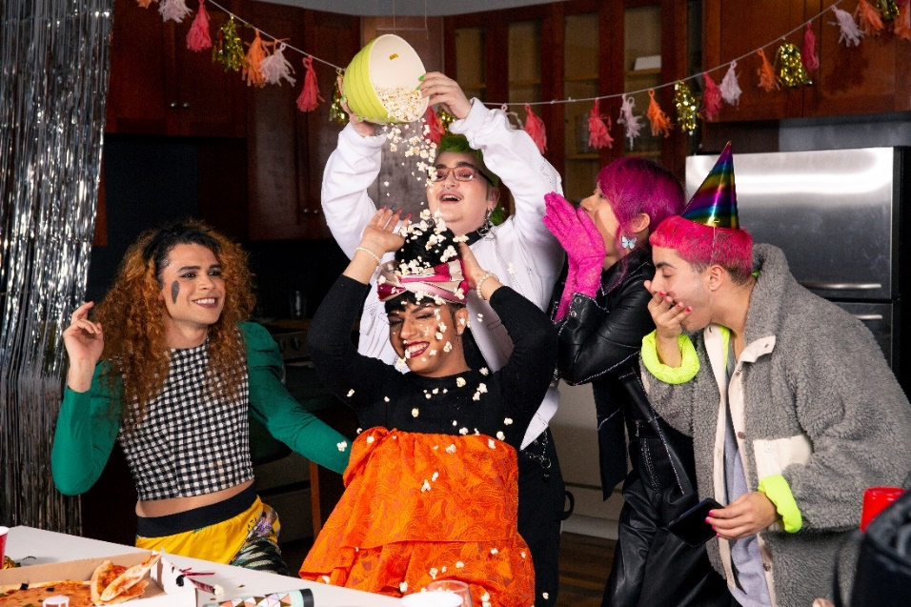
Support & Advocacy
Respect and Awareness
Safety
Equity
Privacy
Notes:
Go through an example of placing a young trans youth.

Slide 17
Resiliency

Slide 18
Training Logistics
Free anywhere in Ohio!
Full-day
5.5 Social Work CEUs
About 30 participants per training
Includes technical assistance
surveymonkey.com/r/safeandsupportedyouth

Slide 19
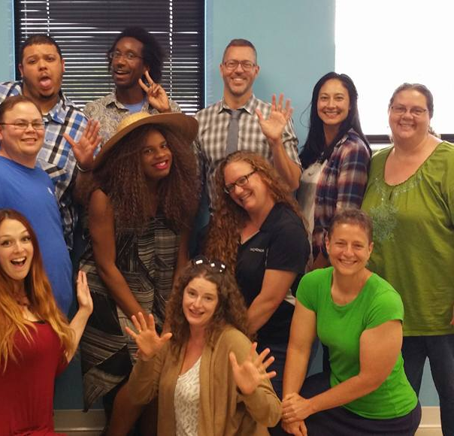
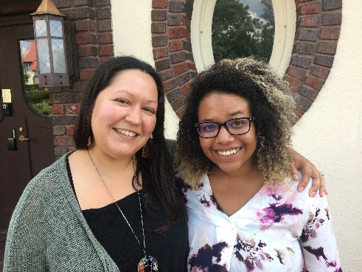
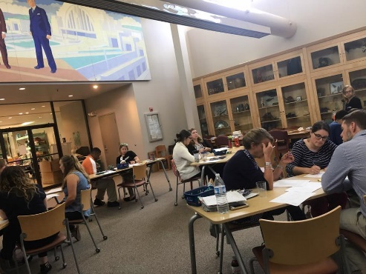
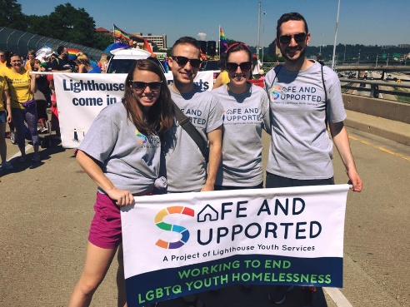
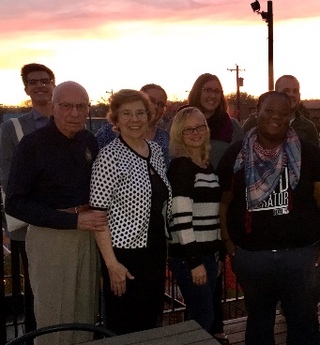
Safe And Supported
The Host Home Program | Cultural Competency Training
Faith in Families | Resource Guides | LGBTQ Advocate
Learn more at: www.lys.org/safeandsupported

Slide 20
Questions?

Slide 21
Thanks!
For further consultation:
Key Beck, LGBTQ Training Specialist
kbeck@lys.org
For further training: https://www.surveymonkey.com/r/safeandsupportedyouth
Michelle Polek, LGBTQ Training Coordinator
mpolek@lys.org / 513-475-6023

