Slide 1
Bridges Regional Meetings June 7thand 14th 2022 10:00am – 1:00pm

Slide 2
Meeting Agenda
Welcome
Landlord-Tenant Rights and Issues Presentation
Housing --Resource list and Use of CIRT-- (Alexis/Trudy)
Dependent Care Checklist (Latasha/Carrie)
*New* Bridges Ongoing Eligibility SACWIS function (Sarah/Dom)
Bridges Referral Data (Eliza)
Marketing/Awareness and Representing Bridges (agencies, ODJFS and Collab)
Good News Stories (Latasha)
Extraordinary Bridges Staff Member Recognitions (Sarah S.)

Slide 3
Landlord-Tenant Rights and Issues
Graham Bowman
Staff Attorney with the Legal Aid Society of Columbus

Slide 4
Housing --Resource list and Use of CIRT
The Housing Resource List is now live on the portal. Please share any additional resources you have with your Regional Coordinator.
Updated Portal documents (Host Home Packet, Emergency and In-Home Housing Guidance)
Emergency Housing - This housing option is temporary and should last no more than 30-days. It is important to get YAs out of emergency housing ASAP
Supportive In-Home – utilized when an individual(s) is allowing the young adult to reside in their home to provide safe and stable housing. In addition, the provider agrees to play an active role in supporting the young adult to become self-sufficient by teaching the young adult crucial life skills and/or including the young adult in household activities. Needs to be proof/documentation that supportive services are being provided.
Utilizing CIRT/Staffing on Housing Cases – If a CIR is issued for a housing related incident (e.g., property damage), select CIRT recommendation on CIR form.
Also, use CIRT for frequent moves/evictions

Slide 5
Dependent Care Checklist
The Dependent Care Checklist was created to guide conversations between the service teams and their participants who are expecting or have dependents.
Reviewing and completing the checklist with the participant during the initial face-to-face visit, 90-day reviews, and prior to termination from program.
The checklist provides a list of various resource information for both the participant and dependent e.g., Help Me Grow, etc.
Accompanied with the checklist is a quick list of items for service teams to remember during face-to-face visits with participants and their dependents.
Both documents will be available on the Bridges Provider portal.

Slide 6
Recording Bridges Ongoing Eligibility NEW Functionality
Bridges Ongoing Eligibility section of SACWIS is to provide a central place to document eligibility/ineligibility timeframes and upload all documentation.
Piloting began May 18th – Thank you to the participating service teams!
Statewide training scheduled for 6/29 at 1:00-2:00p – this training will be recorded and available on the portal to review, but I HIGHLY insist attending so you can ask questions.
Service teams can then begin using the functionality July 1st .
On the Bridges Portal:
Video on creating a record: Creating a Bridges Ongoing Eligibility Record – YouTube
Knowledge Based article with step- by-step screen shots
Recording Bridges Eligibility Guidance Document (pending)

Slide 7
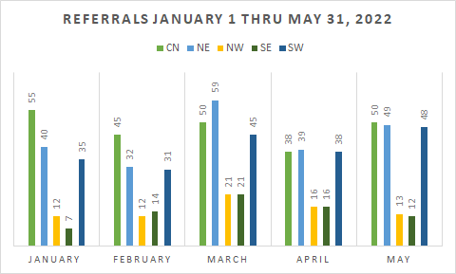
Bridges Referral Data
2022 Highlights
264 Warm Handoffs (33% of all referrals)
382 Re-referrals (48% of all referrals)
Referrals from 82 counties
Young adults living in 83 counties
3 DYS
3 IV-E Juvenile Court
18 YAS Transfers

Slide 8
Marketing, Awareness, & Representing Bridges
Representing Bridges
We are all responsible for the positive representation of Bridges to all stakeholders (participants, PCSA's, each other, employers, schools, courts, etc.)
Use statements such as "Our program rules stipulate a YA must have worked 80 hours per month to be eligible for our program, can you help me with..." vs. "He will be kicked out of the program if..." Or "I know it's a real pain, but the State will kick him out if..."
"Your Bridges application was denied because your school schedule was not dated, can we..." Vs. "I thought your school schedule was fine, but they won't let you in the program unless...".
"This was a bit complicated so I had to elevate the issue for assistance to get the best decision...it may take another day or two; I will follow up" vs. "I don't know what's going on, nobody is telling me anything"
Be careful how you communicate and document issues in emails, AL's, texts, etc.
Marketing and Awareness
Please let your Regional Coordinator know if you need Bridges flyers, posters, information sheets, etc., to hand out to stakeholders
The same as above relates to conveying information or working with others about Bridges

Slide 9
Good News Stories
Look at our Participants' academic achievements:
Pursuing Nursing school after high school graduation.
Attending College and studying Criminal Justice
Earned a full-ride scholarship to Otterbein University
Graduating from high school and will attend Cuyahoga Community College to study Media Arts and technology
Attending YSU, majoring in Psychology, and living on campus
Earned straight A's while in college and inducted into the Phi Theta Kappa Honor Society
Finishing High school and attending Prom
Applied and in the process of enrolling in college
Earned Rise Up credential and points towards graduation AIR test.
This Photo by Unknown author is licensed under CC BY-NC-ND.

Slide 10
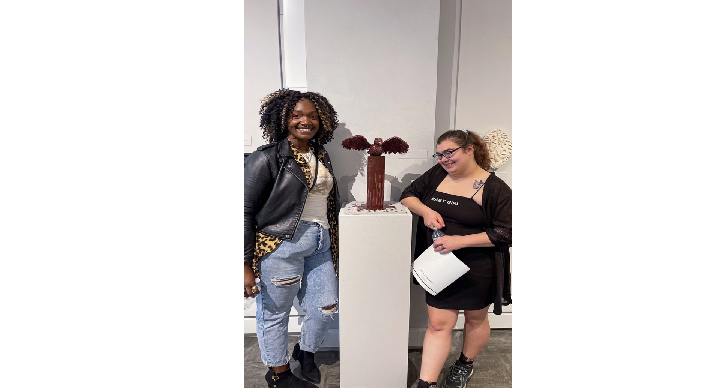
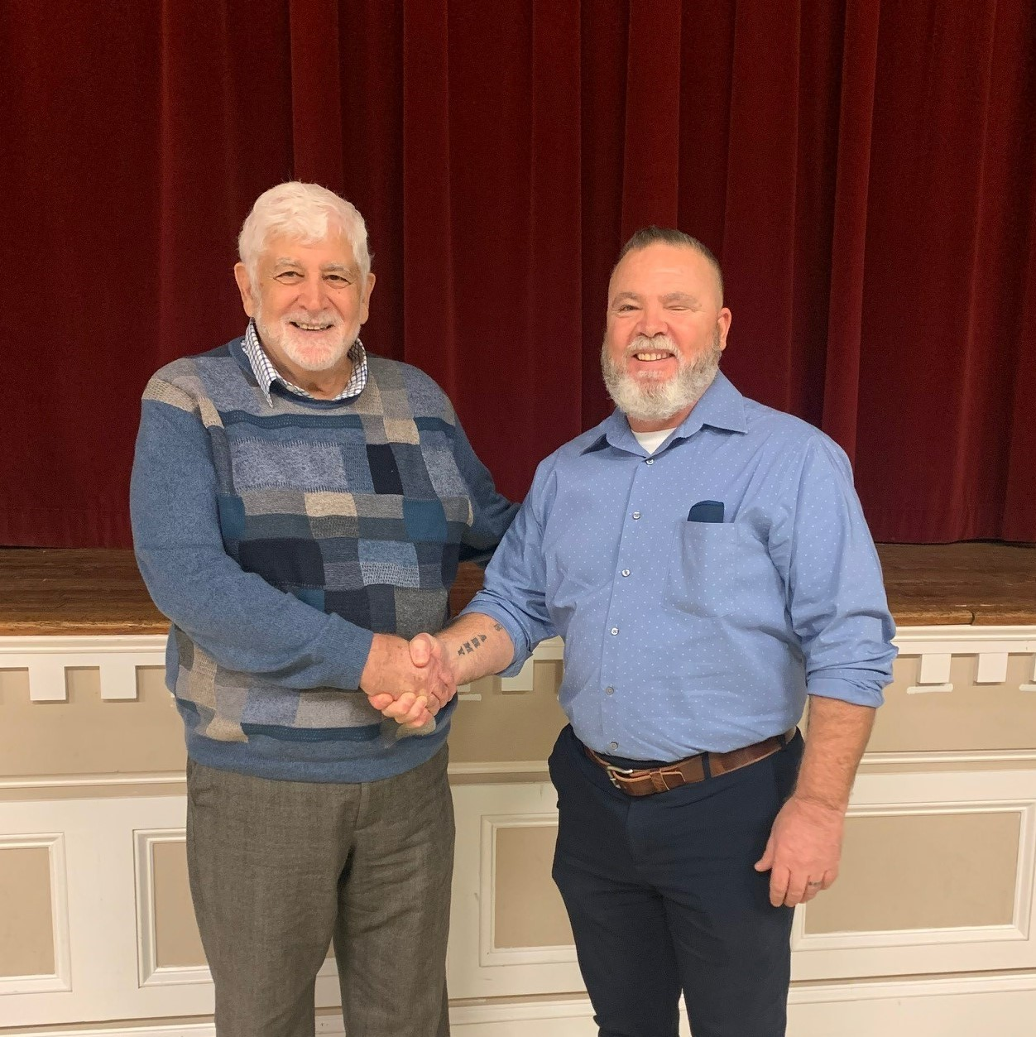
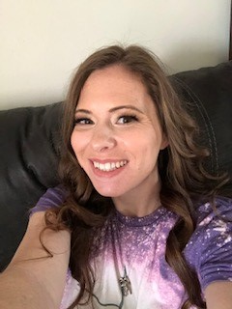
Extraordinary Bridges Staff-Supporting Team in Agency and Program Goals
Jaelisa Felder
Pressley Ridge
Paul Harness
NYAP
Tonya Getter
NYAP

Slide 11
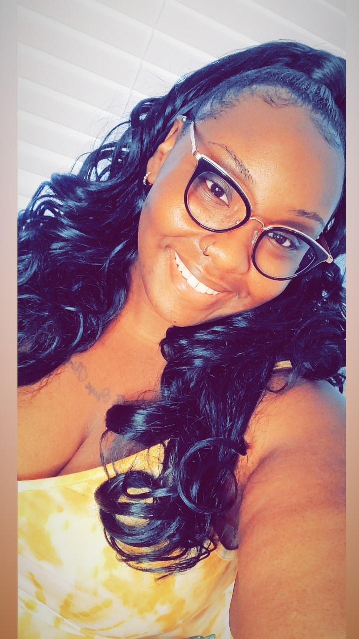
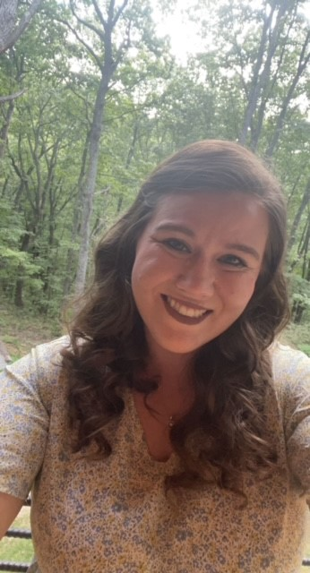
Extraordinary Bridges Staff-Supporting Team in Agency and Program Goals
Allen Pittman
NYAP
Ashley Pinto
Cadence Care Network
Kaitlin Konicek
Pressley Ridge
Chastity Cross
The Buckeye Ranch

Slide 12
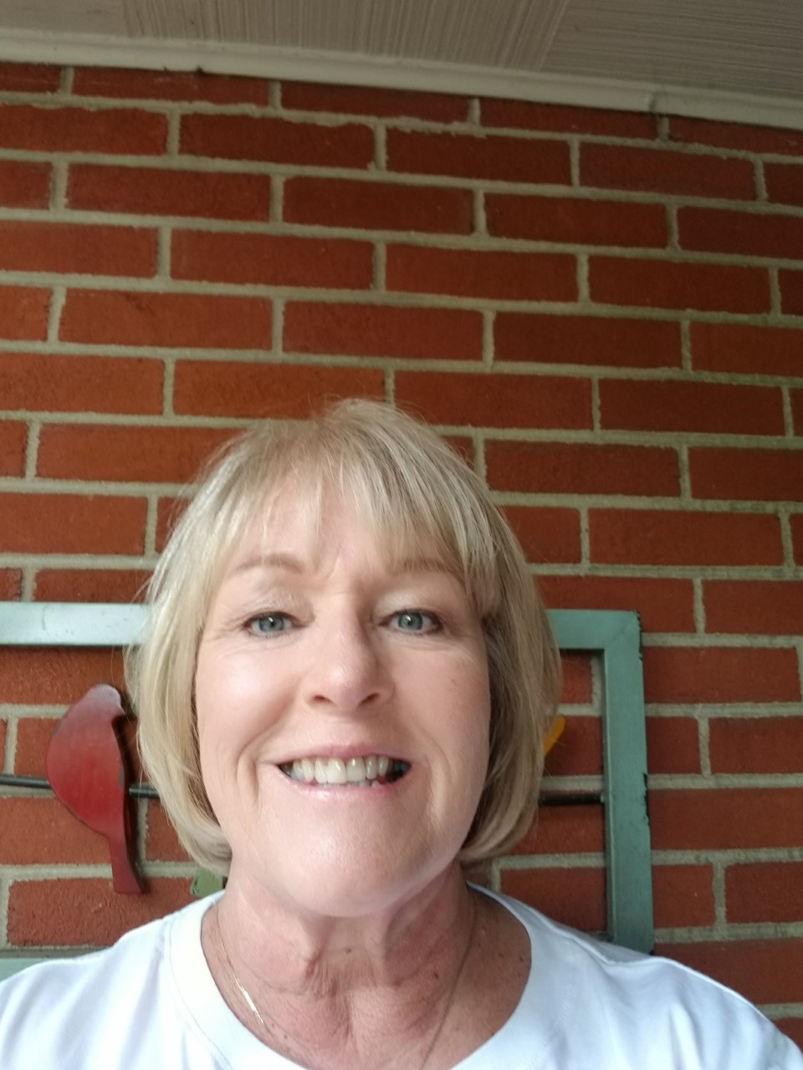
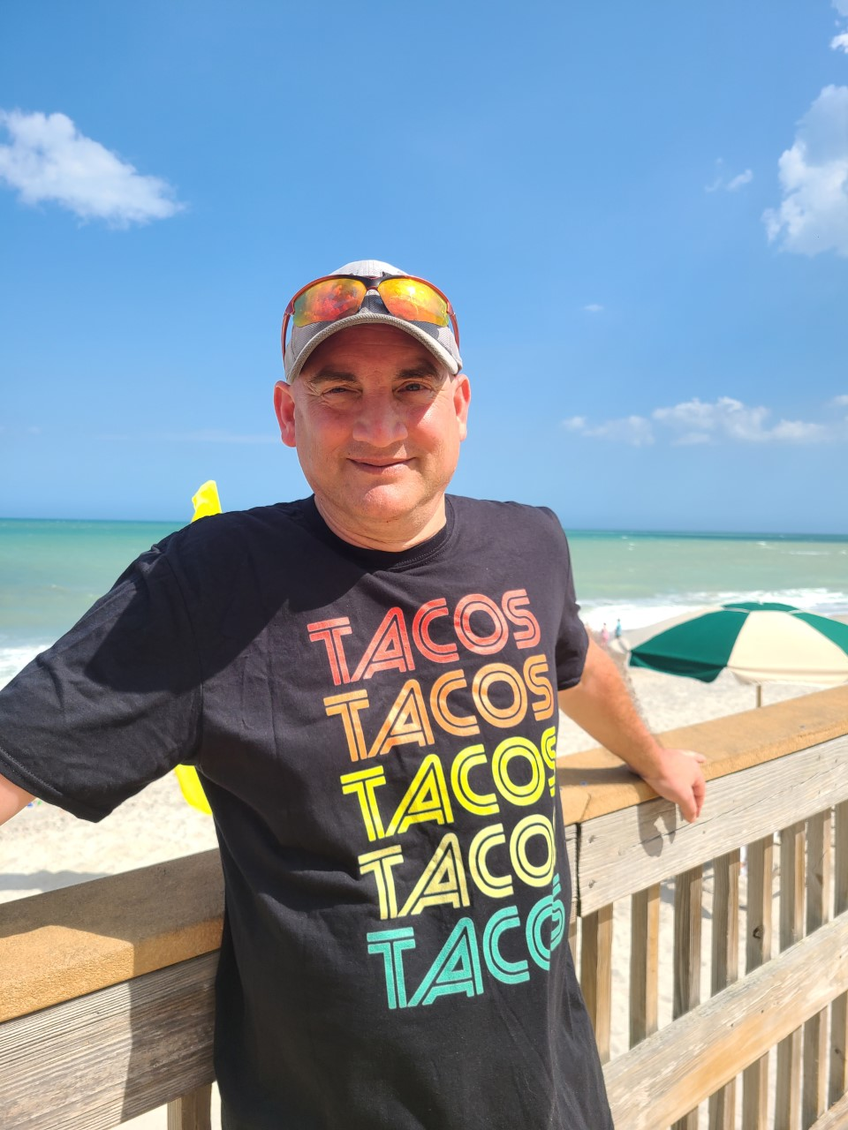
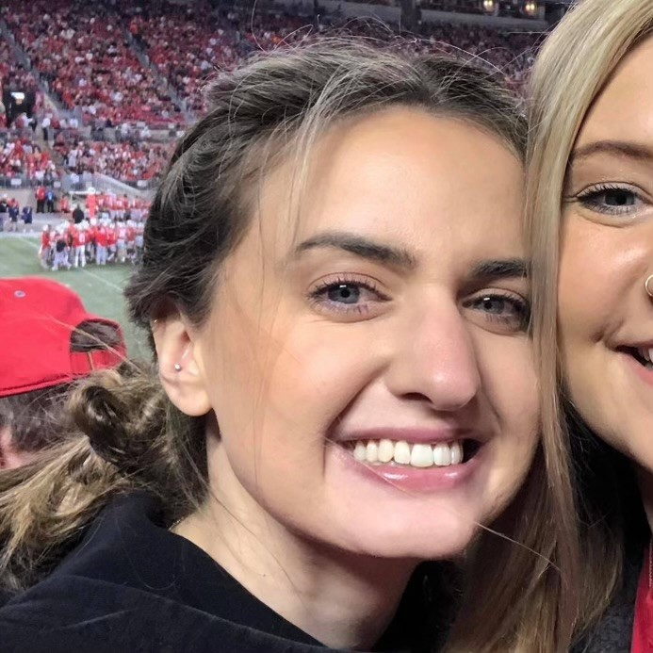
Extraordinary Bridges Staff--Supporting Team in Agency and Program Goals
Sue Workman
The Village Network
Jeff Orbin
Cadence Care Network
Kaitlyn Hall
The Village Network

