Slide 1
Ohio Landlord Tenant Overview
Graham Bowman
The Legal Aid Society of Columbus
gbowman@columbuslegalaid.org
(614) 634-2356

Slide 2


Duties of Landlords and Tenants
Landlord Duties
5321.04
Tenant Duties
5321.05
Put and keep home in a fit and livable condition
Keep all electrical, plumbing, heating, and ventilation systems in good working order
Maintain all appliances and equipment provided or required to be supplied by landlord (no duty to provide appliances)
Keep the home safe & sanitary
Use electrical and plumbing fixtures correctly
Keep the plumbing fixtures as clean as their condition allows
Maintain the appliances provided by the landlord in good working order
Notes:
RESPONSIBILITIES ON BOTH SIDES OF THE FENCE. LAW PURPOSEFULLY DID THAT.

Slide 3

Duties of Landlords and Tenants
Landlord Duties
ORC 5321.04
Tenant Duties
ORC 5321.05
Provide garbage cans and arrange for trash removal, if the landlord owns four or more residential units in the same building
Comply with building, housing, health and safety codes
Dispose of trash properly
Comply with housing, health, and safety codes that apply to tenants
Notes:
GIVE EXAMPLES OF EMERGENCIES.

Slide 4
Duties of Landlords and Tenants
Landlord Duties
Tenant Duties
Evict the tenant when the landlord has “actual knowledge” of drug activity by the tenant, a member of the tenant’s household or a guest of the tenant occurring in or otherwise connected with the tenant’s premises
Do not do illegal drugs

Slide 5

Duties of Landlord
Supply running water, reasonable amounts of hot water and heat, unless the hot water and heat are supplied by an installation that is under the exclusive control of the tenant and supplied by a direct public utility hook-up

Slide 6
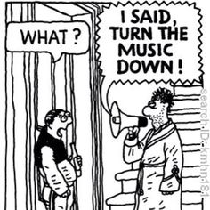

Duties of Tenant
Do not damage the house and keep guests from damaging
Do not disturb any neighbors and require guests to do the same

Slide 7
Prohibited in Rental Agreements/ Leases
Prohibited Terms (not permitted/allowed)
  Tenant required to pay landlord’s attorney’s fees no matter the outcome of a legal dispute
  Force landlord duties onto the tenant
    Example: Repairs
  Make tenant responsible for landlord’s legal mistakes
Prohibited Actions
  No self-help evictions or utility shut-offs
  THE LAW TRUMPS LEASE

Slide 8
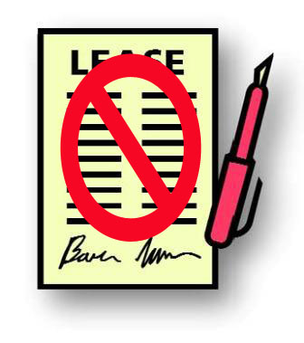
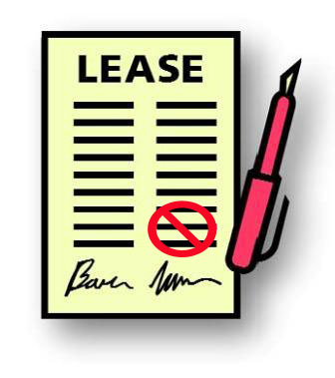
Lease term that is “bad”
Unconscionable (unfair, illegal) terms
  A court may rule to cancel a rental agreement
  -OR-
  A court may choose to cancel only the unconscionable clause
  There is no definition of “unconscionable”
  Often used to attack unreasonable late fees (but reasonable late fees are OK)
Notes:
Court is more likely to do number 2 rather than number 1
UNCONSCIONABLE IS MESSY AND UGLY AND THERE IS NOT MUCH “GUIDANCE;” ASK JOE FOR AN EXAMPLE BESIDES LATE FEES OR CHECK ISKIN.

Slide 9
Repairs and Rent Escrow

Slide 10
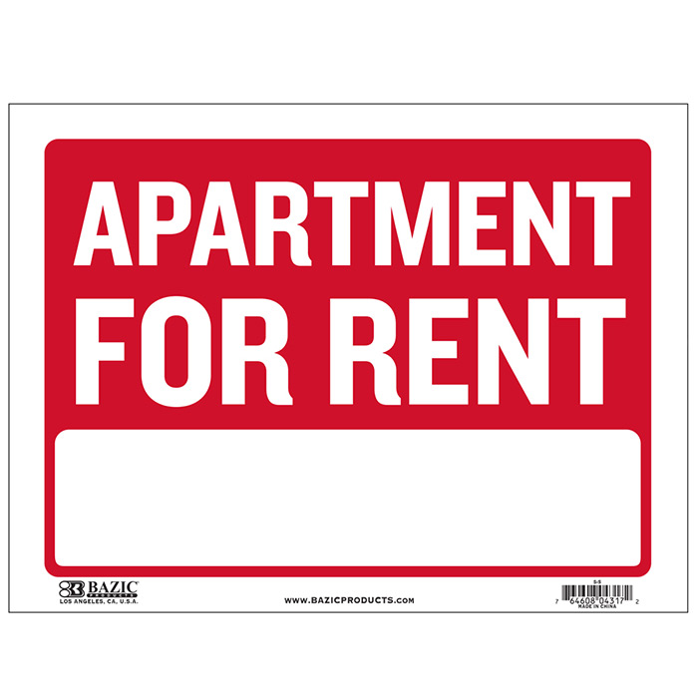
Repairs and Remedy
How do you get your Landlord to make repairs?
The process, called rent escrow, is laid out in ORC 5321.07-10.

Slide 11
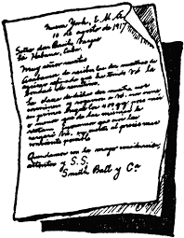

Repairs and Remedy
If you reasonably believe the landlord has failed to fulfill an obligation under the law or lease, such as making a repair in the apartment:
1. Give a written notice (text or email counts) to the landlord about the issue you need fixed.

Slide 12
Repairs and Remedy
2. After the landlord receives the written notice, you must wait a reasonable period of time, no more than 30 days, for the landlord to make repairs.
3. Stay current in rent. You cannot be behind in rent if you want to use the escrow process.

Slide 13
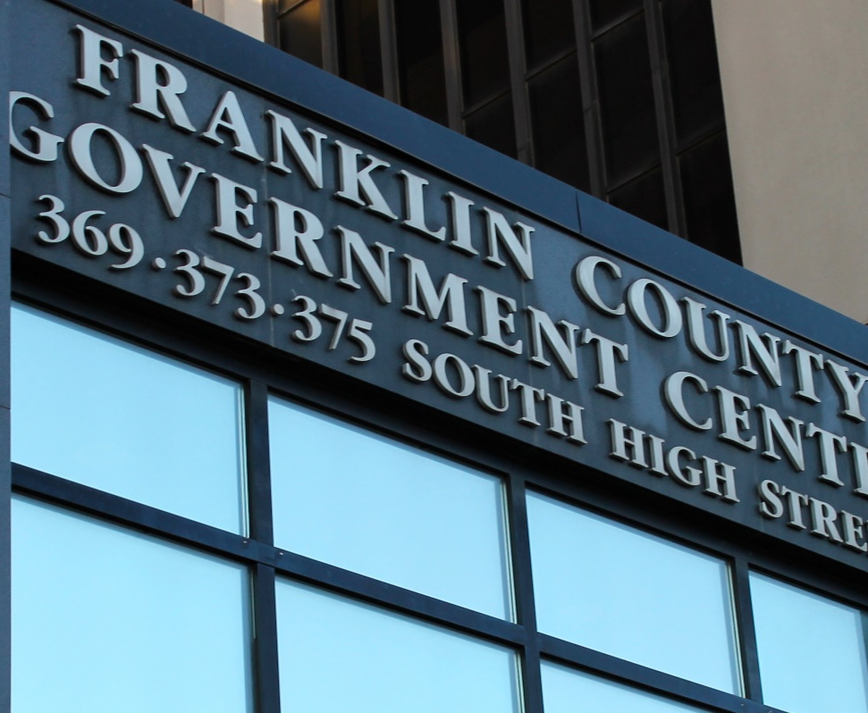
Repairs and Remedy
4. If the landlord makes the repairs, the process ends.
5. If the landlord does not make the repairs within 30 days, you can either start a rent escrow account with the municipal court or terminate the lease. If you choose escrow, you pay rent to the court each month instead of your landlord.

Slide 14

Repairs and Remedy
Calling Columbus Code Enforcement (dial 3-1-1) and asking for an inspection can help support the existence of problems and add another layer of pressure on the landlord to make repairs.

Slide 15
Repairs and Remedy
If you would like more information about the rent escrow process, please visit our website! We have a packet that goes over the escrow process in more detail here:
https://www.columbuslegalaid.org/wp-content/uploads/2016/10/Rent-Escrow-Guide-6-2016-pdf.pdf

Slide 16

Retaliation
Get out.

Slide 17
Typical Retaliation in Columbus
Tenant, frustrated by lack of response to requests for repairs or extermination, calls Code Enforcement and requests an inspection.
Code inspects, issues violation notice to landlord.
Soon thereafter: Retaliation by Landlord. Goal is to get tenant out of the building prior to re-inspection.
In January 2019, City Council passed an ordinance strengthening protections against tenants whose landlords file retaliatory evictions

Slide 18
Ohio Revised Code
R.C. 5321.02
protects a tenant’s right to complain to Code, escrow or ask for repairs
Prohibits landlord retaliation, e.g. raising or refusing rent, evicting because tenant enforced rights, etc.

Slide 19
Ohio Revised Code
5321.02: If Landlord retaliates:
Tenant may use the retaliatory action as a defense to an eviction action.
Tenant may recover possession of the premises.
Tenant may terminate the rental agreement.
Tenant may sue landlord for actual damages with reasonable attorney fees.

Slide 20
Ohio Revised Code
5321.03: Exceptions:
Landlord may not be retaliating if:
Tenant is behind in rent.*
Tenant’s lease has expired and tenant has become a holdover tenant.*
Tenant caused the condition problems
Compliance with Code would require “alteration, remodeling, or demolition of the premises which would effectively deprive the tenant of the use of the dwelling unit”

Slide 21
Eviction
Ohio Revised Code 1923 - Forcible Entry and Detainer (FED).
Who is Subject to Eviction?
  Hold Over Tenants (lease is up)
  Nonpayment of Rent
  Breach of Tenant Obligations that Materially Affect Health and Safety
  Breach of Written Rental Agreement

Slide 22
Non-Payment of Rent
Under Ohio law, a landlord is not required to accept late rent.
If a tenant thinks they will not be able to pay next month’s rent, they should apply for the new 2021 rental assistance funds as soon as possible.
https://www.rentful614.com/

Slide 23
Eviction
Before filing an eviction, a landlord must first give tenant a Three-Day Notice To Leave the Premises (O.R.C. 1923.04)
Can be hand-delivered, sent by certified mail, or left at the premises.
If tenant vacates within the three-day period then no eviction can be filed.
Notice must contain the following language printed or written in a conspicuous manner: “You are being asked to leave the premises. If you do not leave, an eviction action may be initiated against you. If you are in doubt regarding your legal rights and obligations as a tenant, it is recommended that you seek legal assistance.”

Slide 24
Eviction Timeframe
November 1, 2021 – Rent due, with grace period until the 5th.
November 6, 2021 (Saturday) - Landlord tapes a Three-Day Notice to Leave the Premises on tenant’s door with grounds “non-payment of rent”.
The landlord has to wait 3 full days (Sunday, Monday, Tuesday) before filing an eviction complaint at Franklin Municipal Court . In this case, Wednesday, November 10th is the earliest day the landlord can file.
November 10, 2021 - Landlord files eviction complaint. Hearing is set for two weeks out, Wednesday, November 24th.

Slide 25
Eviction Timeframe
November 24, 2021 - The tenant shows up for the hearing and tells the magistrate that they are trying to find an attorney. The Magistrate continues the hearing for one week.
December 1, 2021 - The tenant is evicted for nonpayment of rent. The Landlord purchases a red tag and posts it on the tenant’s door.
December 6, 2021 - Five days later, the bailiff supervises as the tenant’s belongings are set outside the apartment.
If tenants can vacate before the hearing, the eviction can be dismissed as moot, which may look better to future landlords.

Slide 26
Eviction – Common Defenses
If reason for eviction is violation of tenant duty under ORC 5321.05 that affects health and safety, Landlord may have to give the tenant a 30 day notice to cure the violation, before filing the eviction. See R.C. 5321.11

Slide 27
Eviction – Common Defenses
Notice Problems: Landlord did not give a 3 day Notice to Leave Premises (NTLP). Notice did not have required language. Landlord did not wait 3 full days after serving the NTLP before filing the eviction action.
Acceptance of Rent: If landlord serves 3 day NTLP and then accepts rent that could only be applied to future rent, the NTLP is waived and the case should be dismissed.

Slide 28
Eviction – Common Defenses
Unauthorized Practice of Law: If Plaintiff is a corporation, LLC, or partnership, a Complaint signed by non-attorney should be dismissed.
Pattern & Practice of Accepting Late Rent: Landlord who has previously accepted late payments cannot suddenly evict for late payment.

Slide 29
Contact Information
If you need more detailed advice about your situation or you think you might need representation, please contact us at the Legal Aid Society of Columbus. To apply for services call: 614-241-2001 or go to https://onlineintake.oslsa.org/?blsid=112

