Slide 1
Bridges Regional Meetings September 6thand 13th 2022 10:00am – 12:00pm

Slide 2
Meeting Agenda
Welcome
ODJFS Youth Ombudsmen Presentation
Bridges Extraordinary Staff Recognition (Don)
Bridges Supervisor and Liaison breakout sessions
Review Applications (Geoff/Latasha)
Common errors
Data for returned applications
Application Checklist(Trudy/Latasha)
Critical Incident Reports (Alexis/Jen S.)
Brief overview of the process change
Common errors
Bridges CIR Checklist
COVID CIRs
Supervisor review
Fraudulent Documentation Guidance (Sarah L./Genah)
Maintenance distribution and Budgeting (Collab)

Slide 3
ODJFS Youth Ombudsmen
Jenny Stotts, Youth Ombudsman – State of Ohio
Jenny.Stotts@jfs.ohio.gov

Slide 4
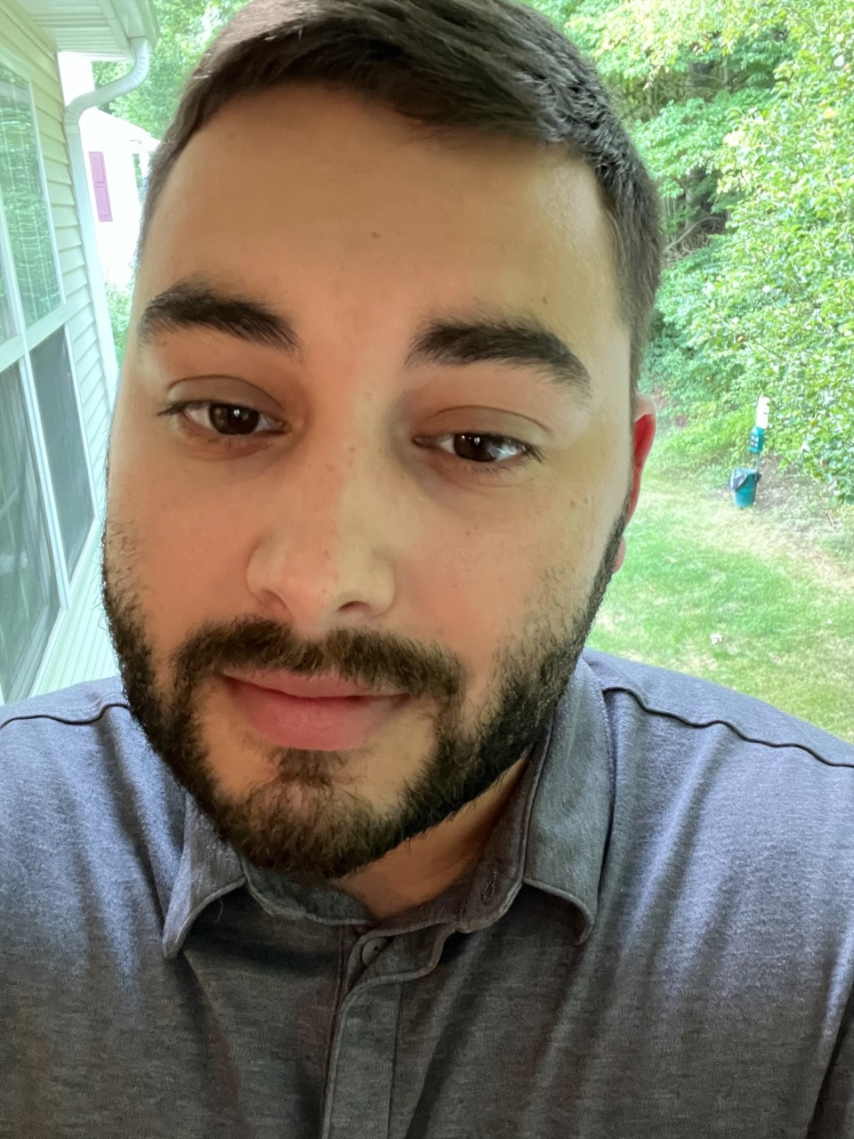
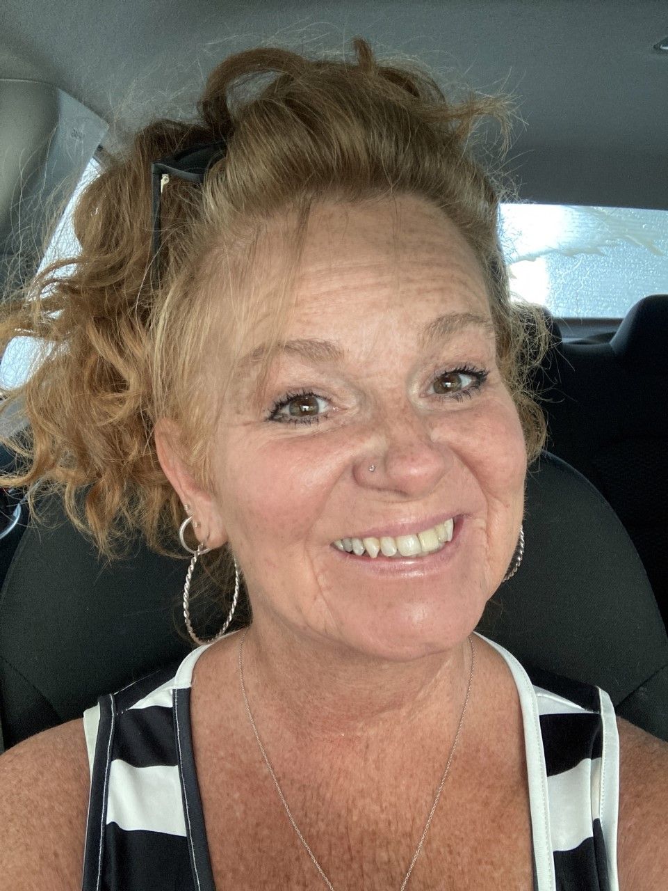
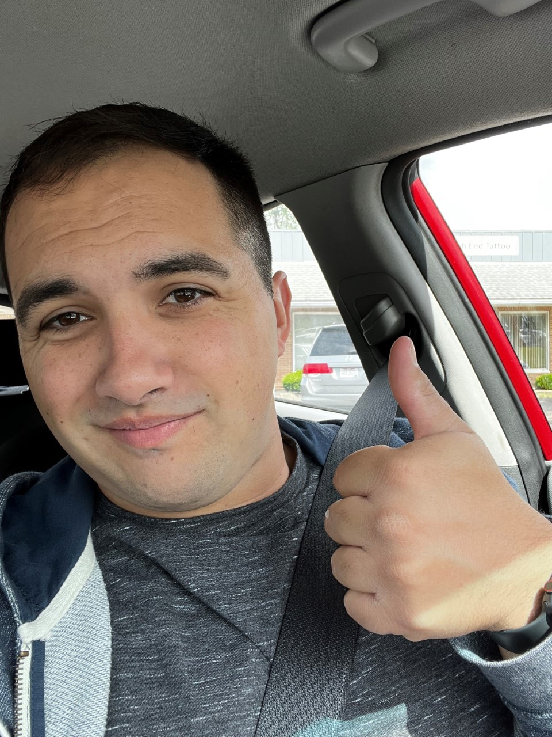
Bridges Extraordinary Staff- Supporting Team in Agency Program Goals
Tyler Legere
Cadence Care Network
Jorja Johnson
The Village Network
Gary Miller
Pathway Caring For Children

Slide 5
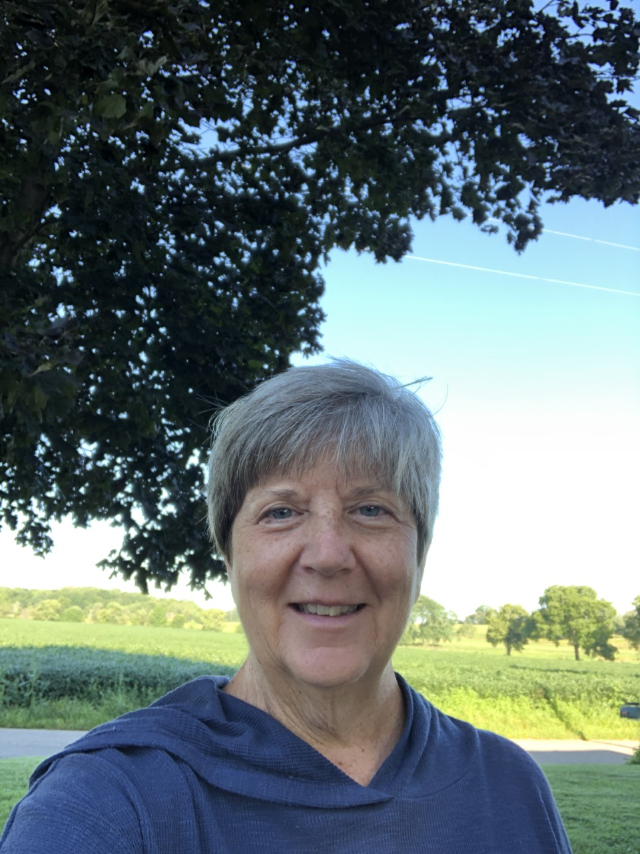
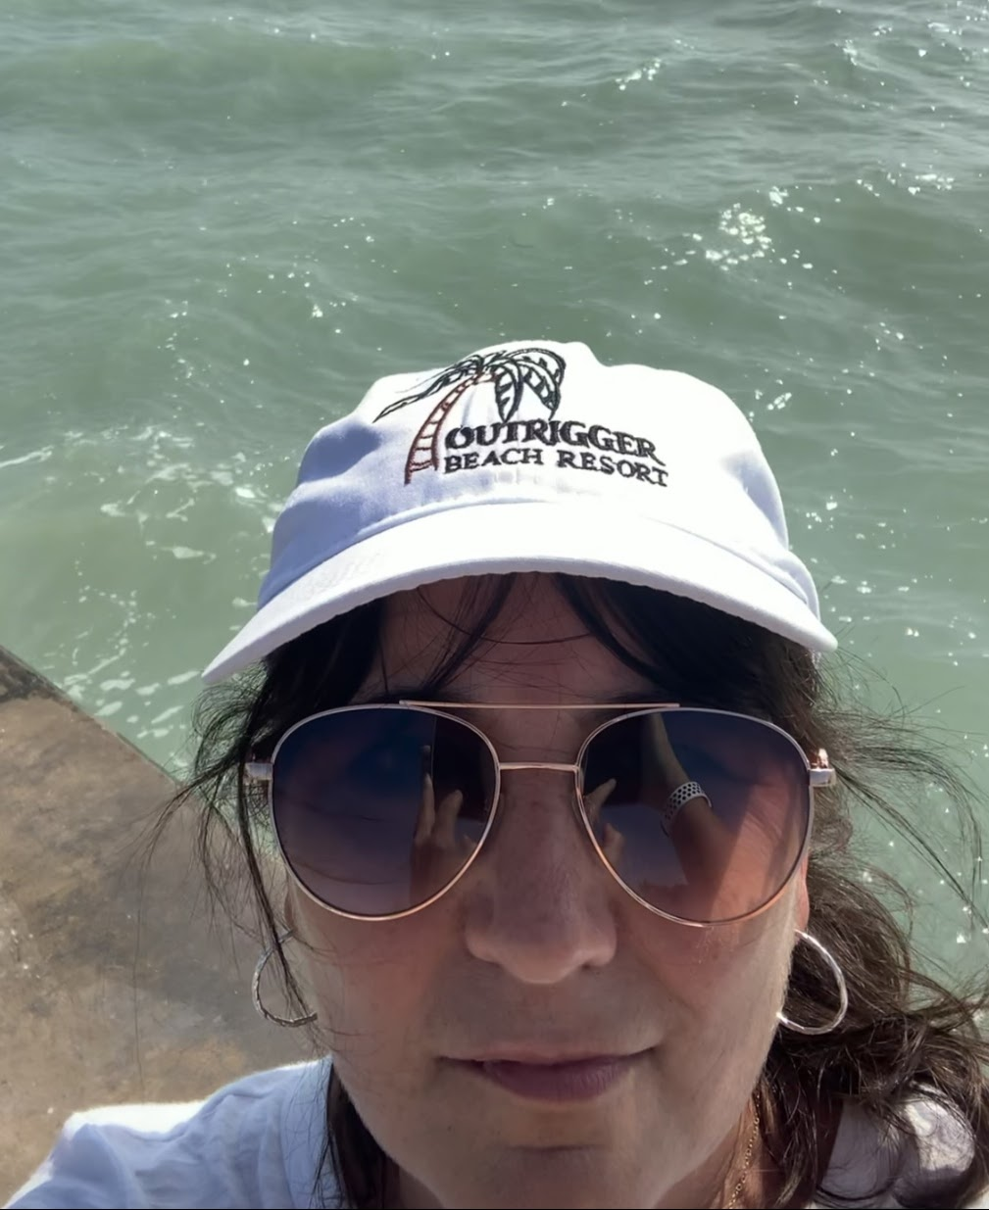
Bridges Extraordinary Staff- Supporting Team in Agency Program Goals
Jana Shira
The Village Network
Lisa Beckman
Agape For Youth

Slide 6
Bridges Supervisor Breakout Session
Review Applications
FY 21-22, a total of 855 applications were submitted with 66% approved the first time, 34% declined at least once, 18-25 % are declined more than once.
Common reasons for declined applications for rework e.g., missing employment information, incorrect school information, missing or incorrect contact information, inaccurate eligibility documentation, DVF incorrect, etc.
Application Checklist
Review the checklist
Supervisors are responsible for reviewing the application (checking for errors) and routing to ODJFS for approval
Critical Incident Report
Overview of the process change e.g., 24-hour email notification, CFHCO review, etc.
Common reasons for a declined CIR form and/or Activity Log
Tips to ensure the accuracy of the CIR form and/or Activity Log and reduce the number of returns for corrections
Supervisors are responsible for reviewing the CIR form and activity log
COVID-19 CIRs
Fraudulent Documentation Guide
Overview of the guide
Examples of fraudulent documentation
Maintenance distribution and budgeting
Creating and reviewing the budget with the Participant at least monthly; supportive documentation in SACWIS
Uploading a copy of each monthly Budget to the Participant’s Bridges Review in SACWIS
Adjusting the budget based on expenses and needs for each month
If the service team is allowing the Participant to self-pay specific bills, verification of timely payment is important e.g., reviewing receipts, recent billing statements, etc.

Slide 7
Bridges Liaison Breakout Session
Review Applications
FY 21-22, a total of 855 applications were submitted with 66% approved the first time, 34% declined at least once, 18-25 % are declined more than once.
Common reasons for declined applications for rework e.g., missing employment information, incorrect school information, missing or incorrect contact information, inaccurate eligibility documentation, DVF incorrect, etc.
Application Checklist
Review the checklist
Supervisors are responsible for reviewing the application (checking for errors) and routing to ODJFS for approval
Critical Incident Report
Overview of the process change e.g., 24-hour email notification, CFHCO review, etc.
Common reasons for a declined CIR form and/or Activity Log
Tips to ensure the accuracy of the CIR form and/or Activity Log and reduce the number of returns for corrections
Supervisors are responsible for reviewing the CIR form and activity log
COVID-19 CIRs
Fraudulent Documentation Guide
Overview of the guide
Examples of fraudulent documentation
Maintenance distribution and budgeting
Creating and reviewing the budget with the Participant at least monthly; supportive documentation in SACWIS
Uploading a copy of each monthly Budget to the Participant’s Bridges Review in SACWIS
Adjusting the budget based on expenses and needs for each month
If the service team is allowing the Participant to self-pay specific bills, verification of timely payment is important e.g., reviewing receipts, recent billing statements, etc.

