Slide 1
Bridges Regional Meetings March 7th and 14th , 2023 10:00 am.-12:30 pm.

Slide 2
Meeting Agenda
Welcome
Youth Navigator Network
Panel Discussion
Legal Field Guide
Uploading Housing Agreements
Budgeting Maintenance
Renter’s Insurance
Extraordinary Staff Recognition
Good News Stories

Slide 3
Youth Navigator Network Presentation
Youth Navigator Network
Marissa Tuma and Veronica Burroughs

Slide 4
Panel Discussion: Ineligibility
Moderator(s):
Genah Babcock – Northwest Regional Coordinator
Jennifer Shoemaker – Policy Developer
Panelist​s for 3/7/23 and 3/14/23 meeting dates:
Chastity Taylor – The Buckeye Ranch
Kari Harris – SAFY
Gary Miller – Pathway
Jorja Johnson – The Village Network

Slide 5
Legal Field Guide
The legal field guide is now available and is a great reference tool for service teams. The guide covers several important key areas that Bridges service teams should know.
General information about the legal process
Understanding the court process
Juvenile court involvement and jurisdiction
Best Interest and Reasonable Efforts findings
Role of the Bridges Liaison
SACWIS documentation
Waiver and court information sheet
Legal counsel for young adults
Preparing for the hearing
Hearing procedures
Case timeline
Communication with the Bridges legal team
Notification to the legal team about case transfer or termination
Updating the legal team with current contact information and address for the young adult
Informing the legal team about any outstanding warrants or legal concerns for the young adult

Slide 6
Uploading Housing Agreements
On 2/13/23, the uploading of documentation expanded to include agreements for all housing types to the relevant Service Tier record. Below are examples of required documentation needed for each housing type.
Supportive In-Home or In-Home: Host Home Agreements (if the In-Home provider has refused to complete/sign the host home agreement, please document this in an activity log).
Leased: Leased agreements; if the young adult is a homeowner, a mortgage or deed document showing ownership.
College Room and Board: Statement of account or other documentation confirming young adult staying in college dorm housing.
Supervised Community or Community Housing: Housing Agreement, Lease Agreement, Intake screening docs discussing housing arrangements, or other docs confirming and providing details of this housing type.
Emergency Housing: If a hotel, documentation can be hotel confirmation or receipt. If a young adult is staying with a friend or adult supporter temporarily, please document in an activity log that you spoke to the emergency housing provider to confirm that the young adult can stay there, for how long, and any other relevant details crucial to the young adult’s stay.

Slide 7
Budgeting Maintenance
We are in the process of developing a budgeting and verification guide that details useful best practices and key reminders for service teams. Budgeting with our young adults is vital to building strong financial management skills. During their enrollment in Bridges, young adults have an opportunity to develop discipline and realistic budgeting goals necessary for long-term self-sufficiency and financial stability. Below are some important key elements and reminders that are necessary for constructing a quality budget and promoting financial management skills for young adults.
Starting the conversation about budgeting during your first meeting
Assessing the young adult’s financial experience and skill level
Flexible disbursement of funds e.g., disburse twice a month on the 15th and 30th, distribute checks, direct deposit, etc.
A budget must Include all earned and unearned income (employment, SSI, child support, etc.).
A budget must reflect the current expenses of the young adult each month.
Maintenance is utilized to meet the young adult’s basic needs
Credit Card debt is not an allowable expense
Cannot allocate maintenance for a savings account
Consistently reviewing budgets at least every month with the young adult
Review budget line items e.g., current bills, rent, insurance, groceries, unexpected expense like car repair, etc.
Discussion about spending habits
Tools for tracking and responsible spending
Detailed activity logs in SACWIS

Slide 8
Renter’s Insurance
Renter’s insurance should be discussed with our Participants in leased housing. In most lease agreements, the landlord may list the renter’s insurance as a requirement.
If the Participant is interested in exploring the renter’s insurance options, it is imperative to help with researching reasonably priced policies or bundle options that offer discounted rates e.g., Car and rental insurance bundle rates.
Lemonade https://www.lemonade.com
Nationwide https://www.nationwide.com
State Farm https://www.statefarm.com
Erie Insurance https://www.erieinsurance.com
When choosing an affordable policy, consider the policy coverage terms and frequency of premium payments. Although maintenance can be budgeted for renter’s insurance but only for a monthly payment cadence.
We cannot future pay the insurance payment premiums that are quarterly, every six months, or annually.
If the Participant refuses to secure the renter’s insurance, educate the Participant about their financial responsibility to cover any damages to the property and defer to the language in the Voluntary Participation Agreement.

Slide 9
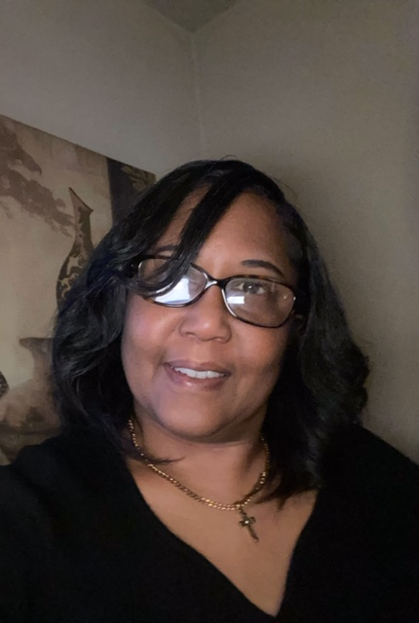
Bridges Extraordinary Staff
Lei Solomon
NOAS
Rose Lee
SAFY
E-zra Poole
South Community

Slide 10
Bridges Extraordinary Staff
Gary Miller
Pathway
Morgan Haynes
Pathway
Adam Nolan
NYAP

Slide 11
Bridges Extraordinary Staff
Jena King
SAFY
Jessica Heilman
Cadence Care Network
Jennifer Wysong
SAFY

Slide 12
Bridges Good News Stories

Slide 13
Final Questions or Comments?
Thank you supporting the Bridges program and for your hard work supporting and inspiring our Young Adults
Please take care of yourselves and each other

